Slide 1

Classification
Logistic Regression
第四组
王玉梓（旅游管理+计科）
杨素芳（计科）
蔡喆（软件工程）
吴海胜（软件工程+在职JAVA开发）

Slide 2
CONTENTS
01 wang
Logistic regression algorithm introduction
02 cai
supplement
03 yang
Case reproduction
04 wu
Thesis analysis

Slide 3

Logistic regression
algorithm introduction
Wang Yuzi (Tourism Management + Computer Science and Technology)
The logistic regression algorithm is explained in plain language. This section starts with the binary classification problem, from the principle of linear regression, logistic regression idea... Expand, using charts, models, examples and code repetition, to explain its ideas and methods, if there are mistakes, please correct.

Slide 4


Brain teasers
What does logistic regression do?
answer：
Used to solve binary classification problems.

Slide 5
What is a classification problem?
For example：
Name | Temperature | vivipation | aquatic | Flight | Have legs | Kind
Frogs | ectotherm | No | halt | No | Yes | amphibians
pigeons | homoiotherm | No | No | Yes | Yes | birds
pigs | homoiotherm | Yes | No | No | Yes | mammalia
bats | homoiotherm | Yes | No | Yes | Yes | mammalia
whales | homoiotherm | Yes | Yes | No | No | mammalia
已有数据
预测分类
Name | Temperature | vivipation | Aquatic | Flight | Have legs | Kind
Cat | homoiotherm | Yes | No | No | Yes | ?

Slide 6
What is a binary problem?
For example：
Name | Temperature | vivipation | aquatic | Flight | Have legs | Whether it is a mammal?
Frogs | ectotherm | No | halt | No | Yes | No (0)
pigeons | homoiotherm | No | No | Yes | Yes | No (0)
pigs | homoiotherm | Yes | No | No | Yes | Yes (1)
bats | homoiotherm | Yes | No | Yes | Yes | Yes (1)
whales | homoiotherm | Yes | Yes | No | No | Yes (1)
已有数据
预测分类
Name | Temperature | vivipation | Aquatic | Flight | Have legs | Whether it is a mammal?
Cat | homoiotherm | Yes | No | No | Yes | ?

Slide 7
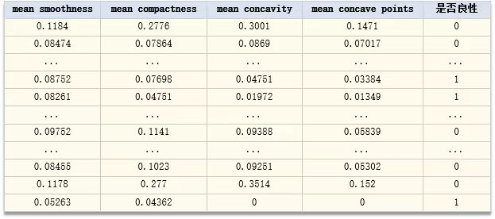
What is a binary problem?
Now we have a set of data,
Each feature needs to be used to predict whether the category of the target is 1 or 0:
This is the binary classification problem, and its purpose is to determine which class a sample belongs to.

Slide 8
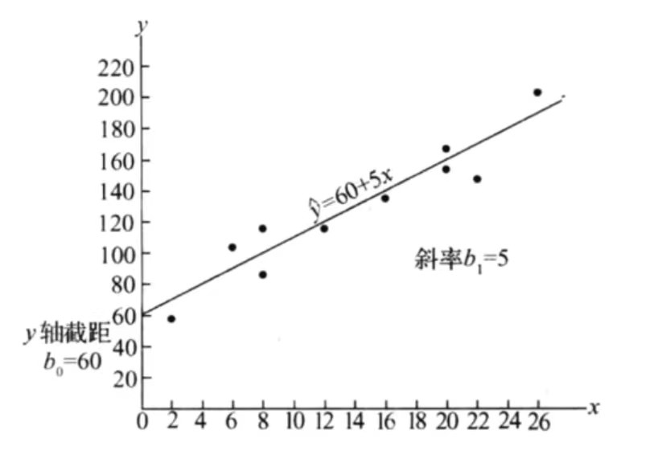
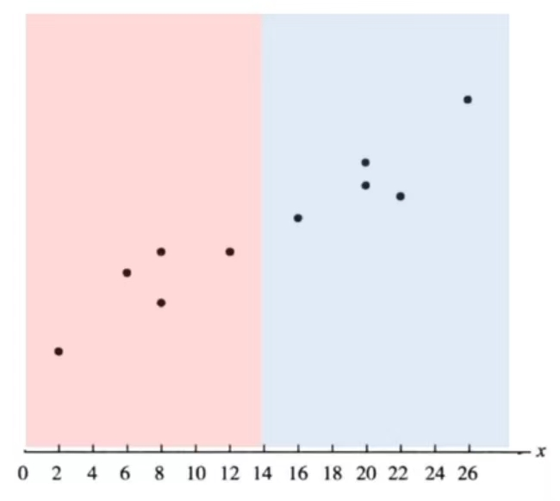
What is the difference between regression and classification?
The output of the regression model is continuous .
The output of the classification model is discrete.
Linear regression

Slide 9

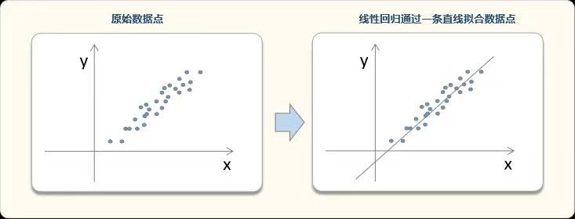
Linear regression idea
Linear regression models fit the data in a straight line.
Linear regression models want to find a straight line (plane or hyperplane) to fit the sample data points.
In the best fitting, the total mean square error between the line and the sample is the smallest.
Eg ： When x is one-dimensional, y and x form a two-dimensional plane, which can be understood as follows:

Slide 10
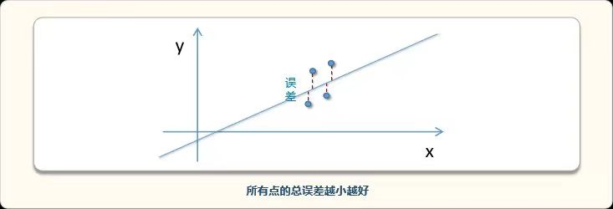
Linear regression idea
The fitting principle is minimum total mean square error

Slide 11
Difference between classification and regression

Slide 12
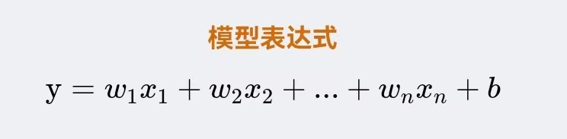
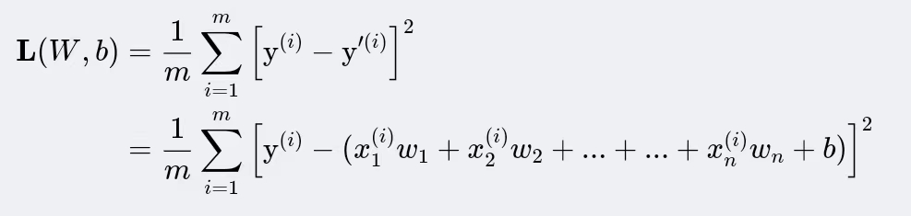
Model expression and loss function
Loss function
The loss function of linear regression is the mean square error of the model's predicted value and the true value.
Note: Superscript (i) represents the i th sample,m is the number of samples, n is the number of variables.

Slide 13
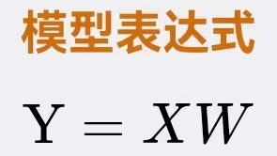
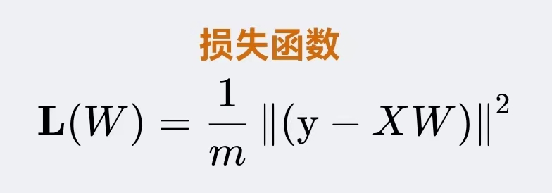
Model expression and loss function
——matrix form
For example, it is often written in matrix form .

Slide 14








Slide 15












Slide 16
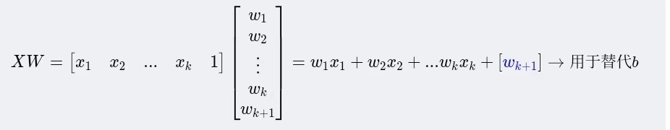
Model expression and loss function
——matrix form
Explanation:
In matrix form, X is the original variable plus a list of constants 1:$[x_{1 }{, x}_{2}{ ...x}_{k} , 1]$
The W corresponds to one more than the original, and the purpose of this is to knead b into the W.

Slide 17
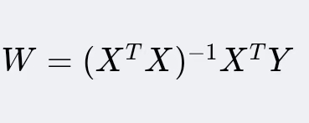
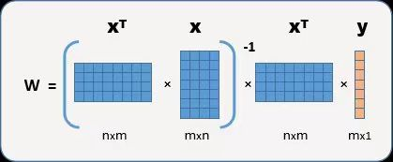
Linear regression model is solved
This section explains how to solve the coefficient of linear regression model.
The linear regression model can be solved directly using the least squares method.
Using this formula, we can find W that minimizes the loss function L(W).

Slide 18









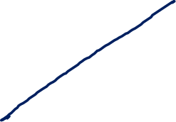






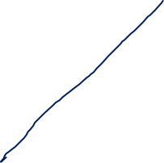














Slide 19
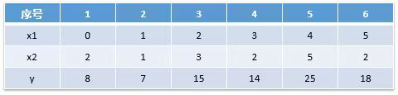
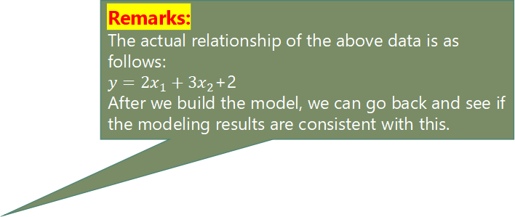
[Example] Linear regression example explanation
This section shows an example of the use of linear regression, including the self-solving code Demo and the code Demo that calls the sklearn package to solve.
problem
Remarks:
The actual relationship of the above data is as follows:
$y={2x}_{1}+{3x}_{2}$+2
After we build the model, we can go back and see if the modeling results are consistent with this.
We need to build a linear model, using the variables $x_{1}$ , $x_{2}$ to predict $y$ .

Slide 20

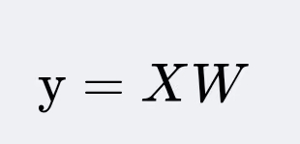
Modeling thinking
In this section, we review the overall idea of linear regression modeling.
certainty model
Assuming that the variables obey a linear relationship, the model is obtained.

Slide 21

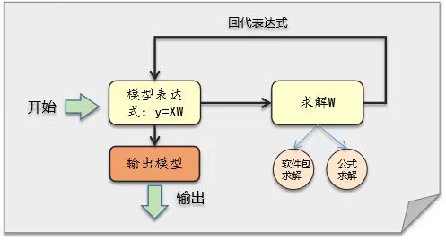
Modeling thinking
In this section, we review the overall idea of linear regression modeling.
Find the best W
The actual steps are simple,
Just add X to a column of 1s, and use the formula to solve for W,
Plug in the model expression, and you get the model.

Slide 22
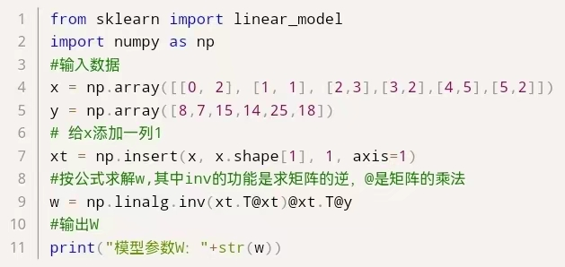
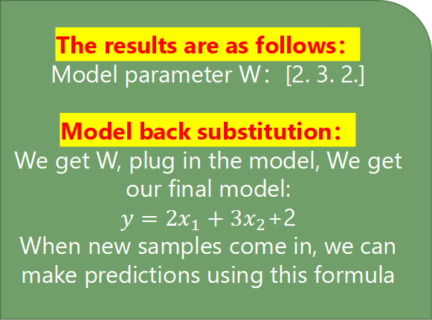
code implementation
In this section, the linear regression model is solved by two methods: self-written code solution and packet transfer solution.
Self written code
According to the solution formula of linear regression model, it can be solved.
The python code is as follows:
The results are as follows：
Model parameter W：[2. 3. 2.]
Model back substitution：
We get W, plug in the model, We get our final model:
$y={2x}_{1}+{3x}_{2}$+2
When new samples come in, we can make predictions using this formula

Slide 23
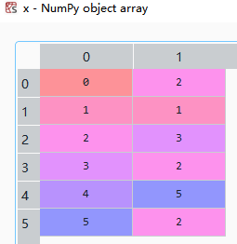
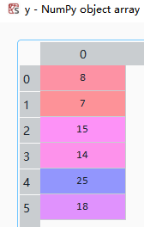
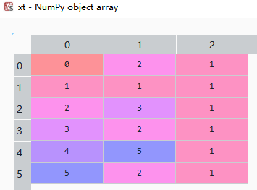
code implementation
In this section, the linear regression model is solved by two methods: self-written code solution and packet transfer solution.
Self written code

Slide 24


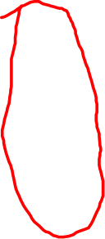

Slide 25
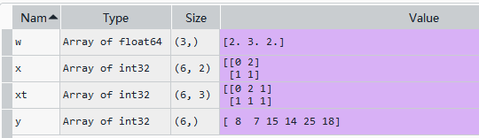
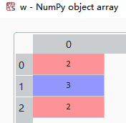
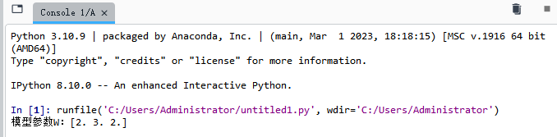
code implementation
In this section, the linear regression model is solved by two methods: self-written code solution and packet transfer solution.
Self written code

Slide 26
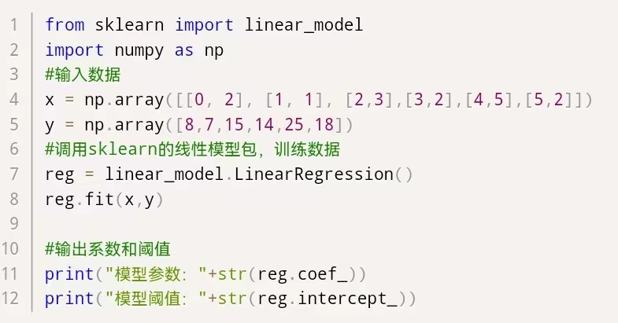
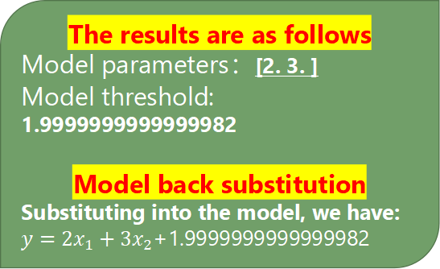
code implementation
In this section, the linear regression model is solved by two methods: self-written code solution and packet transfer solution.
Use the sklearn package
We can also use the linear model method of sklearn in the python machine learning package.
The python code solved with the sklearn package is as follows：
The results are as follows
Model parameters：[2. 3. ]
Model threshold: 1.9999999999999982
Model back substitution
Substituting into the model, we have:
$y={2x}_{1}+{3x}_{2}$+1.9999999999999982

Slide 27
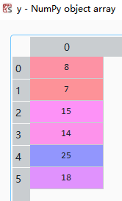
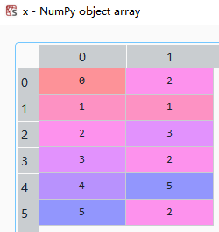
code implementation
In this section, the linear regression model is solved by two methods: self-written code solution and packet transfer solution.
Use the sklearn package

Slide 28
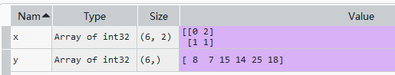
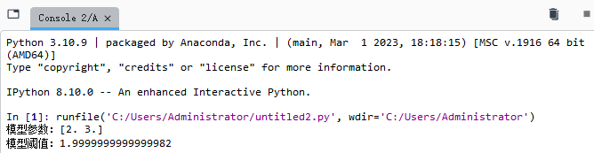
code implementation
In this section, the linear regression model is solved by two methods: self-written code solution and packet transfer solution.
Use the sklearn package

Slide 29
What exactly is logistic regression?
Logistic regression = linear regression + sigmoid function
How do you turn regression into classification？
y greater than 130 is blue
y less than 130 is red

Slide 30
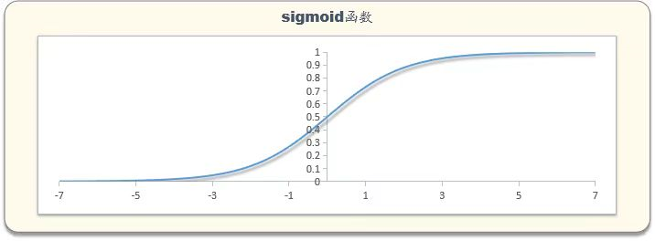
What exactly is logistic regression?
Logistic regression = linear regression + sigmoid function

Slide 31
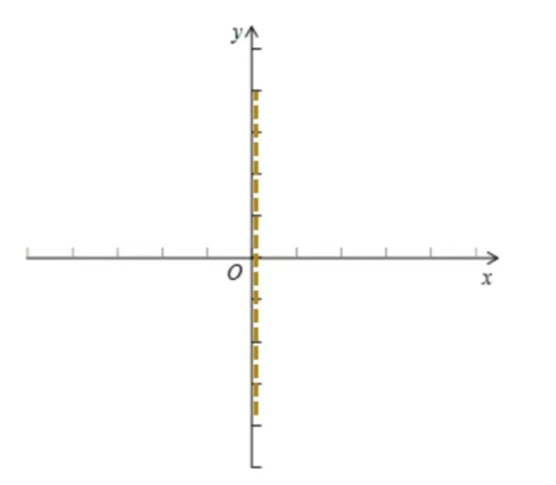
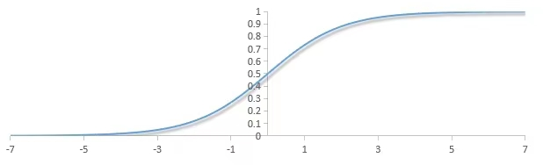
How does the sigmoid function work?

Slide 32

The idea of logistic regression
This section explains the idea of solving binary classification problem by logistic regression.
The relationship between values and probabilities
We know that linear regression fits values that do not fit the needs of our forecast category.
But numbers are also related to categories,
For example, the darker it gets, the greater the chance of rain.
That is, the greater the value, the greater the probability of belonging to a certain class, and the value and probability can be transferred.

Slide 33
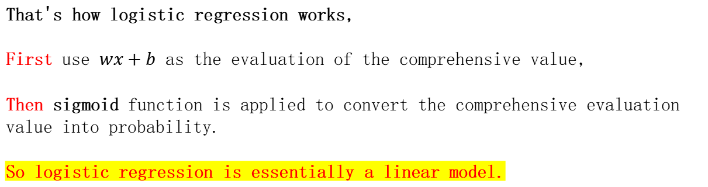
The idea of logistic regression
This section explains the idea of solving binary classification problem by logistic regression.
That's how logistic regression works,
First use $wx+b$ as the evaluation of the comprehensive value,
Then sigmoid function is applied to convert the comprehensive evaluation value into probability.
So logistic regression is essentially a linear model.
Then I touch the concept of information entropy, and then supplement the practical significance of the origin of sigmoid function.

Slide 34




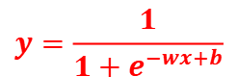
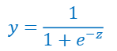
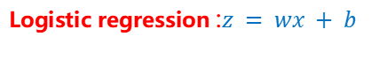
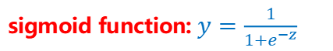
Logistic regression model expression
This section introduces the mathematical expressions of logistic regression models and the properties of interpreting expressions
Logistic regression = linear regression + sigmoid function
linear regression: $z = wx + b$
sigmoid function:$y=\frac{1}{1+e^{−z}}$
$$y=\frac{1}{1+e^{−z}}$$
$$y=\frac{1}{1+e^{−wx+b}}$$
Logistic regression :$z = wx + b$

Slide 35
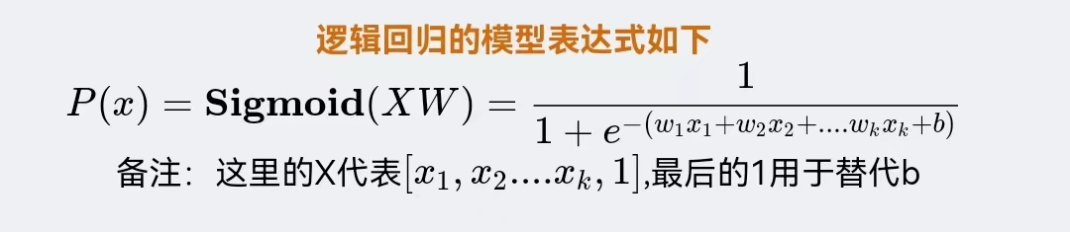
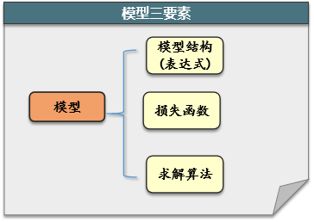
Logistic regression model expression
This section introduces the mathematical expressions of logistic regression models and the properties of interpreting expressions
supplement

Slide 36
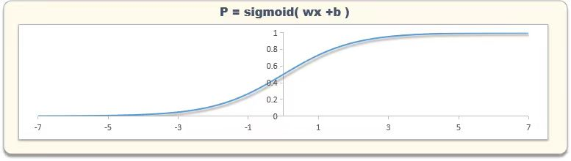
Logistic regression model expression
This section introduces the mathematical expressions of logistic regression models and the properties of interpreting expressions
Logistic regression model characteristic explanation
In univariate, logistic regression model is an S-curve.
Similarly, at two variables it is an S-surface, and at more variables it is a super-S-surface.

Slide 37












Slide 38









Slide 39
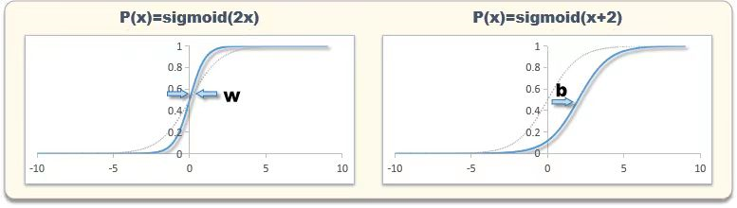
Logistic regression model expression
This section introduces the mathematical expressions of logistic regression models and the properties of interpreting expressions
Logistic regression model characteristic explanation
Where $w$ controls the stretch of the S-curve, and $b$ controls its translation position.

Slide 40
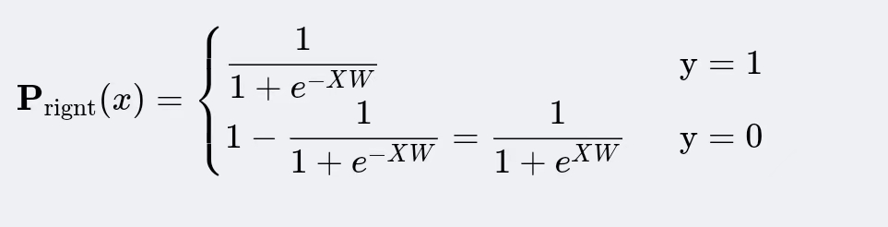
How do you solve for good parameters?
——Loss function
Explanation:
The output of logistic regression is the probability of belonging to class 1,
When the true value y is 1, P is the probability that the evaluation is correct;
When the true value y is 0,P is the probability that the model is wrong, and 1-P is the probability that the model is correct
This section explains the loss function of logistic regression model and the design idea of loss function.
Logistic regression model is used to maximize the probability that the model predicts correctly ~!
A single sample evaluates the probability of being correct
Let's look at the individual samples and evaluate the probability correctly
The probability $P_{right}(x)$ that the model evaluates a single sample correctly is:

Slide 41

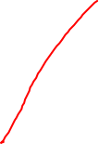






Slide 42









Slide 43






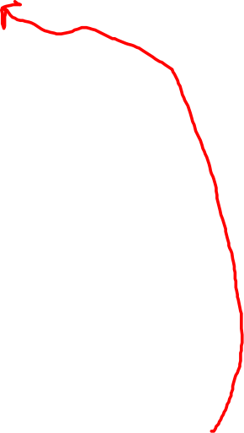




Slide 44
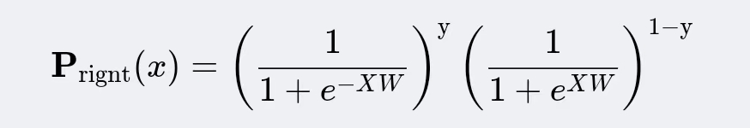
How do you solve for good parameters?
——Loss function
This section explains the loss function of logistic regression model and the design idea of loss function.
The sample evaluates the probability correctly
Explanation:
When y=1, the second bracket is equal to 1
When y=0, the first bracket is equal to 0
After simplification, it is consistent with the above two formulas

Slide 45
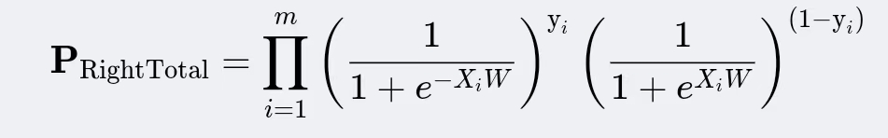
How do you solve for good parameters?
——Loss function
This section explains the loss function of logistic regression model and the design idea of loss function.
The sample evaluates the probability correctly
All samples are evaluated with the correct probability
Assuming that each sample is an independent event,
Then the total probability of evaluating correctly is the product of evaluating correctly for all samples:

Slide 46


How do you solve for good parameters?
——Loss function
This section explains the loss function of logistic regression model and the design idea of loss function.
We expect $P_{Right Total}$ to maximize
Just design the loss function to be $−P_{Right Total}$
Because $P_{Right Total}$ has a lot of multipliers
Let's use a logarithm for ease of calculation.
Note: For the specific process of simplification, see "Logistic Regression Loss Function Derivation Process".

Slide 47



How do you solve for good parameters?
——Loss function
This section explains the loss function of logistic regression model and the design idea of loss function.
Logistic regression loss function - summary of design ideas
The overall idea of logistic regression loss function design is as follows:
The loss function designed in this way is also called the maximum likelihood loss function.

Slide 48

Model solving
This section explains how to solve the loss function of logistic regression model.
Gradient descent
Gradient descent method is a classical numerical solution algorithm

Slide 49


Background of gradient descent problem
In this section, we introduce why gradient descent algorithm is needed, and what problems gradient descent algorithm solves.
In the problem of minimizing a function of one variable,
We usually just set the derivative of $f(x)$ to 0 and solve for $x$.
However, in functions of several variables, it is very difficult to solve for $x$ by taking the partial derivative so that the partial derivative is 0
Therefore, the exact solution of the simultaneous partial derivative equation is not possible.
Our alternative solution is numerical solution, and gradient descent is one of the common methods.

Slide 50









Slide 51






Slide 52

Gradient descent algorithm idea
In this section, we introduce the idea of gradient descent algorithm and discuss the meaning and initialization method of gradient.
Overview of ideas
The idea behind gradient descent is,
Take an initial value x0 and iterate.
Adjust it in the opposite direction of the gradient each time（In one dimension that's the negative side of the derivative）
Until the iteration condition terminates（For example, if the value of f(x) cannot be reduced, the local lowest point is reached）

Slide 53

Gradient descent algorithm idea
It's the direction in which the function falls the fastest（That is, adjust the phase synchronization length, and the negative gradient can make f(x) fall the fastest, so it is also called the fastest descent method）
In this section, we introduce the idea of gradient descent algorithm and discuss the meaning and initialization method of gradient.
About gradient
In a function of one variable, the negative gradient is the opposite direction of the derivative.
In a function of several variables, the negative gradient is the opposite direction of the partial derivatives of each variable

Slide 54

About initial value
From the principle of the algorithm, we can know that gradient descent is very sensitive to the initialization of x, because it can only find the local minimum closest to the initial value. If the initialization is not good, the results found are not good.
It is usually initialized randomly first, and then run several times to see which results are good, and then use which one.

Slide 55

Algorithm flow and flow chart
This section describes the algorithm flow of the gradient descent algorithm and shows the algorithm flow chart.

Slide 56

Algorithm flow and flow chart
This section describes the algorithm flow of the gradient descent algorithm and shows the algorithm flow chart.

Slide 57

Examples and codes of gradient descent method
The following shows the specific process of using gradient descent to find a solution, and see if the results are consistent with our expectations.
problem
It is easy to know that the minimum value of y is 0 at x1=2, x2=3,

Slide 58


01. Manual calculation process
This section shows each step of the gradient descent algorithm through manual calculation.
The calculation process is sorted out
Since the gradient descent algorithm needs to use the objective function gradient, it is necessary to calculate the gradient first, and then set the initial value and learning rate. After that, iterate continuously according to the gradient until the gradient is minimal, and then stop the iteration.

Slide 59

01. Manual calculation process
This section shows each step of the gradient descent algorithm through manual calculation.

Slide 60

02.Code implementation of gradient descent algorithm
This section uses python code programming to show how to implement gradient descent algorithm in code.

Slide 61

Logistic regression example
problem
150 breast cancer data sets were collected: four features and breast cancer categories. Now we need to be able to train a logistic regression through the data to predict whether breast cancer is benign or malignant.
Note: The above data is the data of breast_cancer in sklearn.
Features: average smoothness, average compactness, average concave, average concave points, category: 0-malignant, 1-benign.

Slide 62


Modeling thinking

Slide 63

01, write your own code to solve
The gradient descent method is used to solve the loss function of logistic regression.
The python code is as follows:
Parameter W：[ 7.16215375 14.98708501 -16.84689114 -73.92486786 3.38331608]

Slide 64

02,Call sklearn to solve
In practice, we usually go straight to the packet solution.
Here is the code that calls the solution of the sklearn package:
Model parameters: [[-0.53024026 -3.48636783 -6.89132654 -4.37965412]]
Model threshold: [1.80112869]

Slide 65

The final model result
In practice, we usually go straight to the packet solution.

Slide 66

03,Test the model effect
In this section, a distribution diagram is drawn to test whether the model is distinguishable for two types of samples.
As you can see from the graph, the higher the p value, the more of them belong to category 1.
This shows that the model has a good degree of differentiation between samples.
Model effect test
We draw the 0,1 label distribution of each p-value segment in the training sample:
Note: Logistic regression generally uses AUC or KS as the model evaluation index, which is not expanded here for simplification.

Slide 67


※※※Logistic regression is important

Slide 68

summary(Principles of logistic regression model)
This section reviews and summarizes the three components of logistic regression model: expression, loss function, and solution algorithm.
Three component review of logistic regression model

Slide 69

summary(Principles of logistic regression model)
This section reviews and summarizes the three components of logistic regression model: expression, loss function, and solution algorithm.
Three component review of logistic regression model
As can be seen from the expression, logistic regression model is equivalent to synthesizing all variables with linear function, and then converting the synthetic value into probability value with sigmoid function.

Slide 70


summary(Principles of logistic regression model)
This section reviews and summarizes the three components of logistic regression model: expression, loss function, and solution algorithm.
Three component review of logistic regression model
Loss function of logistic regression
The general form of the loss function:
Cross entropy form of the loss function:

Slide 71

summary(Principles of logistic regression model)
This section reviews and summarizes the three components of logistic regression model: expression, loss function, and solution algorithm.
Three component review of logistic regression model
Logistic regression model solution
The solution for logistic regression in the software package does not necessarily use gradient descent, but the idea is similar.

Slide 72

summary(Gradient descent method is used to solve logistic regression)
This section reviews the process of solving logistic regression by gradient descent method.
The idea and process of gradient descent method to solve logistic regression are as follows:
(1) First, find the gradient formula of the function to be solved (loss function).
(2) Initialize an initial solution and iterate continuously according to the negative gradient direction of the gradient formula until the requirements are met (for example, the maximum number of iterations is reached).

Slide 73

Literature reference
第一章【一元函数微积分】1.2导数与微分——1.2.2机器学习中的常用函数（Logistic 函数的曲线） P20
第二章【线性代数与矩阵论】2.1 向量及其运算——2.1.7（应用——线性回归）P61
第三章【多元函数微积分】3.2梯度与方向导数——3.2.1梯度 P140
第三章【多元函数微积分】3.4雅可比矩阵——3.3.4（应用——最小二乘法）(求解线性回归问题的最小二乘法） P148
第四章【最优化方法】4.2一阶优化算法——4.2.1梯度下降法 P183
第四章【最优化方法】4.3二阶优化算法——4.2.5（应用——人工神经网络） P190
第四章【最优化方法】4.5凸优化问题——4.4.4（应用——logistic 回归） P200
第五章【概率论】——5.7.5（应用——logistic 回归） P285

Slide 74
Case reproduction
Wang Yuzi Yang Sufang ( Computer Science and Technology)

Slide 75



Breast cancer prediction (recurrence 4/normal 2) was performed based on pathological data, and the model was constructed using Logistic algorithm
Data source
http://archive.ics.uci.edu/ml/datasets/Breast+Cancer+Wisconsin+%28Original%29

Slide 76

Breast cancer prediction (recurrence 4/normal 2) was performed based on pathological data, and the model was constructed using Logistic algorithm

Slide 77

Breast cancer prediction (recurrence 4/normal 2) was performed based on pathological data, and the model was constructed using Logistic algorithm

Slide 78

Breast cancer prediction (recurrence 4/normal 2) was performed based on pathological data, and the model was constructed using Logistic algorithm

Slide 79
Logistic regression for multiclassification
Cai Zhe(software engineering)
This section complements the first part. It mainly introduces the origin of the name of logistic regression, and the solution content of logistic regression to polynomial problems is mainly introduced, if there is any error, please correct

Slide 80
Classification or Regression
Obviously it is a classification algorithm, why the name is logistic regression？
This is for historical reasons and the mathematical nature of the algorithm's internals.
historical reasons： Logistic regression originated in the field of statistics in the 1940s and 1950s. During this period, it was used to deal with "regression problems" in biology, that is, predicting probabilities by solving regression models of continuous variables. At that time, scientists usually used linear regression to make predictions for classification problems, but such a method would lead to unreasonable prediction results. For example, for classification problems, prediction values ​​beyond the range of 0 to 1 may be obtained. To solve this problem, logistic regression was introduced.
mathematical nature： Although logistic regression is used to predict probabilities when solving classification problems, it can still be considered a regression model mathematically. The goal of logistic regression is to minimize the difference between predicted probabilities and true labels by finding the best-fitting regression coefficients. So, in mathematical form, logistic regression is very similar to traditional linear regression problems.

Slide 81
Multiple classification for logistic regression
Multi-category learning using binary classifiers can be divided into three strategies:
One vs One（OvO）
One vs. Rest（ OvR）
Many vs Many（ MvM）
OvR is the most commonly used and intuitive method. OvO is also improved on this basis .MVM uses several classes as positive examples and several other classes as negative examples.

Slide 82



Multi-classification of logistic regression
OvR:
The basic idea of ​​One-vs-all classification:
For each category i, train a binary logistic regression model separately
Used to predict the probability that a sample belongs to class i (y = i)
For a new input x, select the maximized class i as the predicted class of x

Slide 83
Multi-classification of logistic regression
Although OVR has the advantages of wide universality and relatively good efficiency, there are also many drawbacks, such as easily causing an imbalance in the number of samples in the training set, especially in cases with multiple categories, where the number of positive class samples is often far less than the number of negative class samples, which can cause bias in the classifier.
Due to the instability of OVR, there has been the emergence of One Vs One. OVO is a relatively robust extension method.

Slide 84
Multi-classification of logistic regression
OvO:
Transforming mindset：
By combining different types of data in pairs to train classifiers, three binary classifiers can be obtained.

Slide 85



Multi-classification of logistic regression
OvO:
Operation mode：
The position of the data to be predicted in the graph is determined by the first classifier as x, the second classifier as a triangle, and the third classifier as x. After voting through the three classifiers, the category of the data can be predicted as x.
Triangle and x trained classifier:
Classifiers trained on triangles and squares:
And the classifier trained with square and x:

Slide 86
Multi-classification of logistic regression
Advantages and disadvantages of OVO：
Disadvantages ：OVO's requirement of N*(N-1)/2 classifiers escalates training time and storage needs for numerous classes. It can lead to inconsistent decisions and susceptibility to noise or overlaps. Efficiency and stability can be concerns in large-scale and complex cases.
Advantages ： OVO method has merits in multi-class classification. It simplifies decision boundaries by training a binary classifier for each class pair, which suits cases with distinct classes. It is also robust against class imbalance and simplifies training data, reducing complexity.

Slide 87

Multi-classification of logistic regression
Comparing OvO and OvR ：

Slide 88
Multi-classification of logistic regression
MVM：
Many-to-many is to use several classes as positive examples and several other classes as negative examples each time. The positive and negative example structure of MvM has a special design and cannot be selected arbitrarily.
Usually "纠错输出(ECOC)" is used to divide the categories after generating the coding matrix.
Error correction output code flow：
Coding: divide N classes M times, each division divides part of the categories into positive examples and part into negative examples, thus forming a training set for two classifications: in this way, there are M training sets in total, and then M classifications can be trained device.
Decoding: M classifiers make predictions on the test samples respectively, and these prediction samples form a code. This code is compared with the respective codes of each class, and the class with the smallest distance is returned as the final prediction result.

Slide 89
Multi-classification of logistic regression
ECOC ：
The classification is specified through the "coding matrix". The coding matrix has various forms, mainly binary and ternary codes
For binary ECOC codes：
Calculate the Hamming distance and · Euclidean distance, and perform XOR operations on binary ECOC codes
For ternary ECOC codes：
the rules are the same as before, but ternary operations do not perform XOR

Slide 90

Multi-classification of logistic regression
European distance and Hamming distance：
The formula for Euclidean distance is as follows:
Hamming distance
The definition of Hamming distance is the number of digits encoded on the corresponding bits of two legal codes.
For example, if 10101 and 00110 have different first, fourth, and fifth digits starting from the first digit, then the Hamming distance is 3.
The function of Hamming distance is to detect and correct errors in encoding

Slide 91
Multi-classification of logistic regression
instance ：
Let's take a look at the case introduction. I used a classic iris dataset for logistic regression for a multiclassification problem. It contains characteristic data of the iris (e.g. petal length, petal width, etc.) and the corresponding category labels (Setosa, Versicolor, Virginica). Our goal is to train a model by logistic regression to predict which category each iris belongs to.

Slide 92
Multi-classification of logistic regression
instance ：
# 在测试集上进行预测
y_pred = clf.predict(X_test_scaled)
# 计算准确率
accuracy = accuracy_score(y_test, y_pred)
print(f"Accuracy: {accuracy:.2f}")
# 在sciview上显示
plt.scatter(X_test[:, 0], X_test[:, 1], c=y_pred, cmap=plt.cm.Paired)
plt.xlabel('Sepal length')
plt.ylabel('Sepal width')
plt.title('Predicted Class Labels')
plt.show()
# 加载鸢尾花数据集
iris = load_iris()
X = iris.data
y = iris.target
# 划分数据集为训练集和测试集
X_train, X_test, y_train, y_test = train_test_split(X, y, test_size=0.2, random_state=42)
# 特征标准化
scaler = StandardScaler()
X_train_scaled = scaler.fit_transform(X_train)
X_test_scaled = scaler.transform(X_test)
# 训练逻辑回归模型
clf = LogisticRegression(multi_class='ovr', max_iter=1000)
clf.fit(X_train_scaled, y_train)
import numpy as np
import matplotlib.pyplot as plt
from sklearn.datasets import load_iris
from sklearn.model_selection import train_test_split
from sklearn.linear_model import LogisticRegression
from sklearn.preprocessing import StandardScaler
from sklearn.metrics import accuracy_score

Slide 93
Multi-classification of logistic regression
Code optimization：
Feature selection and extraction: Try using feature selection or dimensionality reduction techniques, such as PCA, to reduce the number of features and thus speed up training. Use of cross-validation: Consider using cross-validation to more accurately estimate the performance of the model, especially if the dataset is small. Data preprocessing encapsulation: The steps of loading, partitioning, and normalizing data are encapsulated into functions for reuse in multiple places. This improves the readability and maintainability of the code. Model evaluation: In addition to accuracy, try to use other evaluation metrics such as confusion matrix, classification reports, etc. to evaluate model performance more comprehensively.

Slide 94
Multi-classification of logistic regression
A common method of model evaluation：
In evaluating the performance of multiclassification logistic regression models, the following methods are the most commonly used and useful:
Precision and Recall: F1 score（F1 = 2 * (Precision * Recall) / (Precision + Recall)） Classification Report: Confusion Matrix:

Slide 95
Multi-classification of logistic regression
Confusion matrix：
The Confusion Matrix is a table used to evaluate the performance of a classification model, which can help you understand the correspondence between the model‘s predictions and the actual situation. For binary classification problems, the confusion matrix is typically a 2x2 matrix with the following four elements: - True Positives (TP):Actual is positive, prediction is positive
- False Positives (FP):The actual number is negative, and the prediction is positive
- True Negatives (TN):Actual is negative, prediction is negative
- False Negatives (FN):The actual is positive and the forecast is negative.

Slide 96
Multi-classification of logistic regression
Example of a confusion matrix：
 | Actual Ture | Actual False
Forecast Positive | TP | FP
Forecast Negative | FN | TN
Based on the confusion matrix, we can calculate some important categorical indicators: - Accuracy: (TP + TN) / (TP + FP + TN + FN)
- Precision: TP / (TP + FP)
- Recall (Recall): TP / (TP + FN）
- F1 score: 2 * (precision * recall) / (precision + recall）

Slide 97
Multi-classification of logistic regression
Additions to obfuscation functions：
In a multiclassification problem, the confusion matrix expands to the form N x N, where N is the number of categories, similar to the case of binary classification, where each cell represents the number of times the model predicts one category to another.

Slide 98
Multi-classification of logistic regression
Cross-entropy loss function：
In multi-classification logistic regression, the cross-entropy loss function is a commonly used loss function to measure the difference between the model's predictions and the actual labels. It is widely used in multi-classification problems because it can effectively measure the prediction error in classification problems and can guide the learning of the model during the optimization process.

Slide 99
Algorithmic supplement
WU HAISHENG+Cai Zhe
This section mainly introduces the algorithms commonly used in machine learning: stochastic gradient descent algorithm and feature extraction, combined with code implementation, designed to explain as comprehensively as possible, while being well understood by beginners, so you can understand even if you have no knowledge or relatively poor foundation. If there are any deficiencies, correct them

Slide 100
Feature extraction methods
one-hot and TF-IDF are currently the most common methods for extracting text features.
One-hot encoding：
This is done by using N-bit status registers to encode N states, each with its own register bits, and only one of them is valid at any one time。
Take an example：
 | 体态 | 身高 | 物种
奥特曼 | 类人（1） | 高（1） | 来自M78的智慧生物（1）
怪兽 | 非人（2） | 高（1） | 不知道哪里来的物种（2）
铠甲勇士 | 类人（1） | 正常（2） | 地球上的人类（3）
小猪佩奇 | 非人（2） | 矮（3） | 地球上的猪（4）

Slide 101
Feature extraction methods
One-hot encoding：
Here species have 4 values ，we use 4 status bits to represent this feature, one-hot coding is to ensure that only 1 bit of a single feature in each sample is in state 1, and the others are 0.
1
0001
2
0010
3
0100
4
1000
This can be said to be body and height, so a new representation of these sample features can be obtained and each state bit is treated as a feature to obtain a feature vector:
 | Body | Height | Species
A | 01 | 001 | 0001
B | 10 | 001 | 0010
C | 01 | 010 | 0100
D | 10 | 100 | 1000
Feature vectors
[0,1,0,0,1,0,0,0,1]
[1,0,0,0,1,0,0,1,0]
[0,1,0,1,0,0,1,0,0]
[1,0,1,0,0,1,0,0,0]

Slide 102
Feature extraction methods
One-hot applications：
Learning makes me happy
Learning makes family happy
Not studying makes me unhappy
Separate the words and take all of them, then number each of them:
1.Learning 2.makes me 3.makes family 4.not studying 5.unhappy 6.happy
Then use one hot to extract the feature vector for each paragraph：
Learning makes me happy → 1,1,0,0,0,1
Learning makes family happy → 1,0,1,0,0,1
Not studying makes me unhappy → 0,1,0,1,1,0

Slide 103
Feature extraction methods
Analysis of advantages and disadvantages:
advantage ：First, it solves the problem that the classifier is not good at handling discrete data
Second, to a certain extent, it also plays a role in expanding the characteristics
disadvantage ：First, it isa bag-of-words model that does not consider the order between word
Second, it assumes that words are independent of each other;
Finally, the features it obtains are discrete and sparse.
from sklearn import preprocessing
enc = preprocessing.OneHotEncoder() # 创建对象
enc.fit([[0,0,3],[1,1,0],[0,2,1],[1,0,2]]) # 拟合
array = enc.transform([[0,1,3]]).toarray() # 转化
print(array)

Slide 104


Feature extraction methods
IF-IDF:
IF-IDF is one of the most commonly used text notations in information retrieval (IR). The idea of the algorithm is also very simple, that is, to count the word frequency (TF) of each word, and then attach a weight parameter (IDF) to it.

Slide 105
Feature extraction methods
Advantages and disadvantages of IF-IDF:
Advantages: simple and fast, the results are more realistic Disadvantages: Purely considering word frequency, ignoring the position information between words and the interrelationship between words.

Slide 106
Contrast
Ascend and fall：
In fact, the gradient ascending algorithm is similar to the descent algorithm, the main difference is the maximization or minimization of the objective function and the direction of parameter update. Parameters are updated in the positive direction of the gradient during gradient ascending iteration to maximize the objective function; Parameters are updated in the negative direction of the gradient during gradient descent iteration to minimize the objective function.

Slide 107

Stochastic Gradient Descent（SGD）
For example:
Now, map this scenario to a mathematical problem. Let's say you have a function, which we call the objective function, and it's like that mountain. Your goal is to find the lowest point of this function, which is the bottom of the valley. The input parameters of the function are like your position on the hillside, and the function value indicates your altitude at this location.

Slide 108




Stochastic Gradient Descent（SGD）
The stochastic gradient descent algorithm is like "going downhill" on this function. But it has a small difference: instead of taking a step in the direction of the steepest descent every time, it chooses a random direction. It's like when you go down a mountain, instead of always going in the steepest direction, you choose a random direction, sometimes left, sometimes right, sometimes forward, sometimes backward.

Slide 109


Stochastic Gradient Descent（SGD）

Slide 110
Stochastic Gradient Descent（SGD）
The main steps of the stochastic gradient descent algorithm:
1.Initialization parameters: Select random initial model parameters. 2.Select Learning Rate: Determines the step size each time the parameter is updated. 3.Traverse the dataset: Perform the following steps for each training sample: Calculate losses. Calculate gradients. Update parameters.
4.Repeat iterations: Repeat step 3 until a predetermined number of iterations is reached or the loss function is sufficient to converge.

Slide 111
Stochastic Gradient Descent（SGD）
Give an example:
Suppose we have a simple linear regression problem where we want to fit a straight line by stochastic gradient descent so that it minimizes the mean squared error. Our goal is to find a straight line that best fits the following data points: X = [1, 2, 3, 4, 5] y = [2, 3, 4, 5, 6] When using the stochastic gradient descent (SGD) algorithm, we want to fit the data and reduce the loss function by iteratively updating the parameters.

Slide 112
def compute_gradient(X_batch, y_batch, theta):
num_samples, _ = X_batch.shape
gradient = np.zeros(theta.shape)
for i in range(num_samples):
x_i = X_batch[i]
y_i = y_batch[i]
prediction = np.dot(theta, x_i)
error = prediction - y_i
gradient += 2 * error * x_i
return gradient / num_samples
# 数据
X = np.array([[1, 1], [1, 2], [1, 3], [1, 4], [1, 5]])
y = np.array([2, 3, 4, 5, 6])
# 训练模型
learned_theta, mse_history = stochastic_gradient_descent(X, y, learning_rate=0.01, num_epochs=100, batch_size=1)
# 绘制拟合曲线
plt.scatter(X[:, 1], y, label='Data')
plt.plot(X[:, 1], np.dot(X, learned_theta), color='red', label='Fitted Line')
plt.xlabel('X')
plt.ylabel('y')
plt.title('Linear Regression with SGD')
plt.legend()
plt.show()
# 绘制均方误差随迭代次数的变化
plt.plot(range(1, 101), mse_history)
plt.xlabel('Epoch')
plt.ylabel('Mean Squared Error')
plt.title('MSE Reduction with SGD')
plt.show()
Stochastic Gradient Descent（SGD）
Code for Python:
import numpy as np
import matplotlib.pyplot as plt
def stochastic_gradient_descent(X, y, learning_rate=0.01, num_epochs=100, batch_size=1):
num_samples, num_features = X.shape
theta = np.zeros(num_features) # 初始化参数向量
mse_history = []# 用于保存均方误差随迭代次数的变化
for epoch in range(num_epochs):
permutation = np.random.permutation(num_samples)
X_shuffled = X[permutation]
y_shuffled = y[permutation]
for i in range(0, num_samples, batch_size):
X_batch = X_shuffled[i:i + batch_size]
y_batch = y_shuffled[i:i + batch_size]
gradient = compute_gradient(X_batch, y_batch, theta)
theta -= learning_rate * gradient #更新参数
mse = np.mean((np.dot(X, theta) - y) ** 2) # 计算均方误差
mse_history.append(mse)
return theta, mse_history

Slide 113


Stochastic Gradient Descent（SGD）
Simple mathematical example:
f(x1, x2) = 0.1 * x1^2 + x2^2

Slide 114

Stochastic Gradient Descent（SGD）
Different learning rates:

Slide 115

Stochastic Gradient Descent（SGD）
Different learning rates:

Slide 116

Stochastic Gradient Descent（SGD）
Different learning rates:

Slide 117
Stochastic Gradient Descent（SGD）
optimize:
Here is a more common method: learning rate scheduling
Some common learning rate scheduling strategies are:
Step Decay:
Exponential Decay :
Cosine Annealing ：
ReduceOnPlateau:
Cyclical Learning Rates:
Warmup:

Slide 118
Stochastic Gradient Descent（SGD）
Step Decay :
Step Decay is a commonly used learning rate scheduling strategy that reduces the learning rate with a fixed step size during the training process. Specifically, the learning rate scales by a predefined factor after a specific number of steps (epoch) of training. This factor is usually less than 1 to gradually reduce the learning rate in order to converge more steadily to the optimal solution later in training.

Slide 119
Stochastic Gradient Descent（SGD）
Step Decay :
The following are the main steps of step decay: 1. Select Initial Learning Rate: At the beginning of training, you need to choose an initial learning rate, usually based on experience or some initial experiments. 2. Select Decay Factor and Step Size: The Decay factor determines how much the learning rate scales after each number of steps. The number of steps is an integer value that indicates how many training steps (epoch) followed by the decay of the learning rate. 3. Update Learning Rate: After each number of steps, multiply the current learning rate by the decay factor to get the new learning rate. This new learning rate will be used in the next step. 4. Repeat training: Continue model training with the updated learning rate. After each number of steps, the learning rate gradually decreases, allowing the model to converge more precisely.

Slide 120
# 定义超参数
learning_rate = 0.1
decay_rate = 0.9
decay_steps = 10
# 训练模型
losses = []
for epoch in range(100):
for i in range(X_b.shape[0]):
xi = X_b[i]
yi = y[i]
z = np.dot(xi, theta)
y_pred = sigmoid(z)
gradient = (y_pred - yi) * xi
theta -= learning_rate * gradient
if (epoch + 1) % decay_steps == 0:
learning_rate *= decay_rate
# 计算损失
z_all = np.dot(X_b, theta)
y_pred_all = sigmoid(z_all)
loss = compute_loss(y, y_pred_all)
losses.append(loss)
Stochastic Gradient Descent（SGD）
# 绘制损失下降曲线
plt.plot(losses)
plt.xlabel('Epoch')
plt.ylabel('Loss')
plt.title('Loss Decay with Step Decay')
plt.show()
# 使用训练好的参数进行预测
def predict(X, theta):
X_b = np.c_[np.ones((X.shape[0], 1)), X]
z = np.dot(X_b, theta)
y_pred = sigmoid(z)
return y_pred.round()
# 生成新的数据点进行预测
new_data = np.array([[0.5, 0.5], [-1, -1]])
predictions = predict(new_data, theta)
print("Predictions for new data:", predictions)
Python case:
import numpy as np
import matplotlib.pyplot as plt
# 生成一些示例数据
np.random.seed(0)
X = np.random.randn(100, 2)
y = (X[:, 0] + X[:, 1] > 0).astype(int)
# 添加偏置项
X_b = np.c_[np.ones((X.shape[0], 1)), X]
# 定义逻辑函数
def sigmoid(z):
return 1 / (1 + np.exp(-z))
# 定义损失函数
def compute_loss(y_true, y_pred):
epsilon = 1e-15
y_pred = np.clip(y_pred, epsilon, 1 - epsilon) # 避免log(0)
loss = - (y_true * np.log(y_pred) + (1 - y_true) * np.log(1 - y_pred)).mean()
return loss
# 初始化参数
theta = np.random.randn(X_b.shape[1])

Slide 121
Stochastic Gradient Descent（SGD）
To sum up:
In conclusion, the stochastic gradient descent algorithm is a simple and effective optimization algorithm for finding the lowest point of a function. It moves through the parameter space in a random fashion in the expectation of reaching the global nadir point while being efficient on large-scale datasets.

Slide 122
Multi-classification of logistic regression
Definition of the cross-entropy loss function：
In a multi-classification problem, suppose there are C categories, and the actual label of each sample is a C-dimensional one-hot encoded vector that indicates which category the sample belongs to. The prediction output of the model is a C-dimensional probability distribution vector representing the probabilities for each category. The cross-entropy loss function is defined as follows:
L(y, y_hat) = -sum(y_i * log(y_hat_i))
y: The one-hot encoding vector of the actual tag. In a multiclassification problem, if there are C categories, the actual label of each sample is represented by a C-dimensional vector where only one element is 1 (representing the class of that sample) and the rest are 0. y_hat: The model's predicted output vector. In a multiclassification problem, the model generates a predicted probability for each class, resulting in a C-dimensional vector. y_i: The i-th element of the actual label vector, that is, the tag value of the i-th category. y_hat_i: The model predicts the i-th element of the output vector, which is the model's prediction probability for the i-th category. "sum" represents the sum operation and "log" represents the natural logarithm.

Slide 123
Multi-classification of logistic regression
Steps to apply the cross-entropy loss function：
steps | description
1 | Define the model structure： Choose an appropriate multiclass logistic regression model, such as a linear model or support vector machine.
2 | Define the loss function： Use the cross-entropy loss function to measure the difference between the model's predicted output and the actual labels.
3 | Forward propagation： Forward propagation calculations are performed on each input sample to obtain the predicted output of the model
4 | Calculate losses： Use the cross-entropy loss function to calculate the difference between the model's predictions and the actual labels.
5 | Backpropagation： The gradient of the loss function on the model parameters is calculated, and the model parameters are updated by the backpropagation algorithm.
6 | Optimization algorithm： Use optimization algorithms such as gradient descent to minimize the cross-entropy loss function and adjust parameters.

Slide 124
Multi-classification of logistic regression
Techniques for optimizing the cross-entropy loss function：
skill | description
1. Learning rate adjustment | Choose the appropriate learning rate to accelerate model convergence, but avoid shocks caused by excessive learning rate. You can try different learning rates and use a learning rate decay strategy.
2. Regularization | Introduce L1 or L2 regularization terms into the loss function to control model complexity and reduce the risk of overfitting.
3. Batch normalization | Batch normalize input data to improve training speed and model performance.
4. Random initialization | Initialize the model parameters randomly at the beginning of training to avoid falling into the local optimal solution.
5. Early stop strategy | Monitor the performance of the validation set, and when the performance is no longer improving, terminate the training early to prevent overfitting.

Slide 125
Thesis analysis
Wang Yuzi Wu Haisheng( Software engineering )

